Slide 1
Visual Studio 2010 SharePoint Tools
Getting Up to Speed on SharePoint Developer Tools
Notes:
Visual Studio 2010 introduces SharePoint Developer Tools without any additional installers! In this module you’ll learn how to use the new tools effectively to create business solutions that target SharePoint 2010 farms. You will learn how to create, test and debug SharePoint projects with features, feature receivers, list instances and mapped folders. You will also learn how to extend the SharePoint Developer Tools with some of the more popular extensions such as Visual Studio 2010 SharePoint Power Tools and CKS:DEV.

Slide 2
Agenda
Introduction to the SharePoint Tools
Creating a SharePoint Project
Adding SPIs to a SharePoint Project
SharePoint Tools Extensibility

Slide 3
SharePoint 2007 Development
Experience in Visual Studio is limited
Visual Studio Extensions for WSS (VSeWSS)
Visual Studio Tools for Office with Visual Studio 2008
SharePoint developers reliant on community tools
Developers forced to deal with grungy details
Writing queries and views using CAML
Understanding layout of SharePoint Root directory
Editing manifest.xml
Building *.wsp file for solution package deployment
Notes:
The developer experience for SharePoint 2007 has been less than ideal due to a lack of tool support, wizards and designers. Many developers coming from a background with .NET and ASP.NET development have been frustrated at the need to write batch files, work in the command line and write XML in a under-documented language know as Collaborative Application Markup Language (CAML).
The functionality of Visual Studio Extensions for WSS 3.0 was much improved as it evolved from version 1.0 to 1.3. Although even the latest version does not provide an end-to-end solution for SharePoint development. Many SharePoint 2007 developers have an arsenal of community tools to accomplish many of the required tasks within SharePoint development.

Slide 4
SharePoint Developer Tools in Visual Studio 2010
SharePoint Developer Tools
Provide an end-to-end developer story for SharePoint 2010
Extend the VS project system for SharePoint Projects
Provides project item templates for SharePoint objects
Automatically builds solution package for SharePoint Project
Extensible by 3rd party developers
Caveat: works with SharePoint 2010 not SharePoint 2007
Benefits to SharePoint developers
Abstracts away details of SharePointRoot directory
Abstracts away details of building *.wsp file
Lessens / eliminates need for external utilities
Notes:
The Visual Studio 2010 SharePoint Tools (SPT) represents a significant step forward for professional developers using SharePoint.
SharePoint Explorer follows quick exploration through a site. This makes it possible to launch browser at specific place within site.
SharePoint 2010 introduces a new project structure as well as project templates and project item templates. There are designers to create things like features and solution packages.
One of the most appealing aspects of SPT is that it is extensible
You can add your own custom project templates and item templates.
You can add menu commands into the Visual Studio UI.

Slide 5
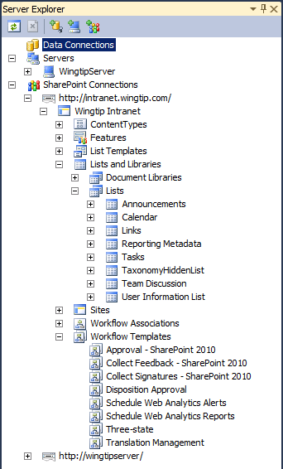
SharePoint Explorer
Add-in for Server Explorer tool window
Easy way to examine site artifacts
Quick way to launch browser into site
SharePoint Explorer extensibility options
Developers can write add-ins to populate nodes and provide contextual menu commands
Notes:
One of the add-ins in Visual Studio 2010 is the SharePoint Explorer.
The SharePoint Explorer is a simple easy-to-use tools:
It provides a read-only treeview of a SharePoint site.
Note that SharePoint Explorer only works on sites that are running locally.

Slide 6
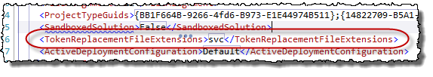
Automatic Post-Build Replaceable Tokens
VS2010 SharePoint 2010 Developer Tools includes many post-build replaceable tokens
Certain tokens are replaced after project builds:
$SharePoint.Project.AssemblyFullName$
By default, only some files are affected:
ASPX, ASCX, XML, WEBPART, DWP
Can add to the list of file types:
Add <TokenReplacementFileExtension> to project file
Useful for custom Web services
Notes:
When creating SharePoint 2007 solutions, such as custom application or site pages that include code behind files, you’re often stuck having to manually enter the fully qualified strong name (aka: 5-part name) of the class of the code behind piece of the page within the <% @Page %> directive. Specifically you’re doing something like this in the Inherits attribute: Namespace.ClassName, AssemblyName, Version=1.0.0.0, Culture=neutral, PublicKeyToken=UnreadableString.
Thankfully Visual Studio 2010 addresses this for us and makes life SIGNIFICANTLY better. There are now a slew of tokens that are replaced when the project is built. So you could now instead put something like this in your custom site and application pages:
<% @Page […] Inherits=”$SharePoint.Project.AssemblyFullName$” %>
Then, when the project is built it will automatically replace this token with the real value. For a full list of all available tokens, refer to the VS2010 SharePoint Development Tools documentation on MSDN:
http://msdn.microsoft.com/en-us/library/ee231545.aspx
Only certain file types are subject to this automatic search-replace for performance reasons. This keeps the search-replace from taking a long time after every build for large projects.
However if you’re looking to include another file type in the list of files to be part of this replacement process you can add to this list. for instance when you are creating custom WCF Services (*.SVC). You can do this either in your project or for your entire workstation. To do this for your project, open the project file (eg: *.csproj) and within a <PropertyGroup> add a new <TokenReplacementFileExtension> entry who’s contents are just the file extension. If you want to make it global to all projects on your workstation, follow the same process above except do it to the SharePoint MSBuild targets file (c:\Program Files\MSBuild\Microsoft\VisualStudio\v10.0\SharePointTools\Microsoft.VisualStudio.SharePoint.targets). This file is used in all builds of projects that use the Visual Studio 2010 SharePoint Tools.

Slide 7
DEMO
Examining a site from Visual Studio 2010 using the SharePoint Explorer

Slide 8
Agenda
Introduction to the SharePoint Tools
Creating a SharePoint Project
Adding SPIs to a SharePoint Project
SharePoint Tools Extensibility

Slide 9
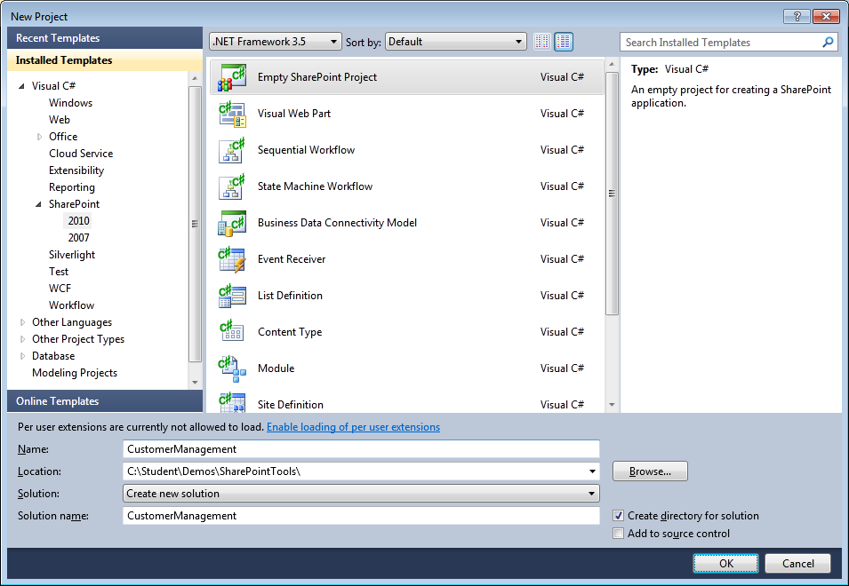
SharePoint 2010 Project Templates
SharePoint Tools provide several project templates
All project templates generate "SharePoint project"
SharePoint projects have extended set of properties and behaviors
Notes:
The SharePoint Tools in Visual Studio 2010 provide several project templates depending of which type of SharePoint artifact you want to develop. There are project templates for web parts, application pages, list definitions, content types, workflows, etc.

Slide 10

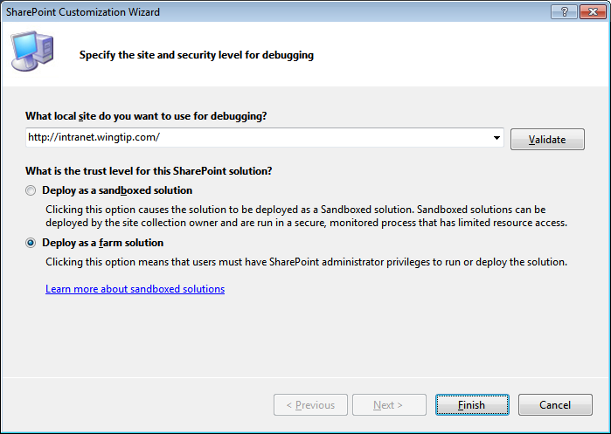
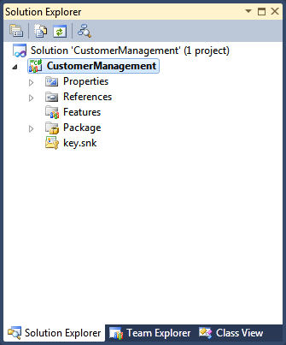
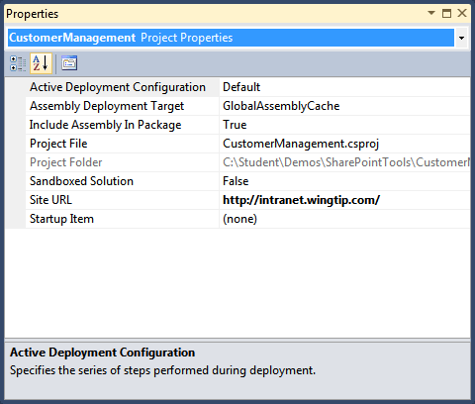
SharePoint 2010 Project Properties
SharePoint Projects properties
Project File
Project Folder
Active Deployment Configuration
Include Assembly in Package
Assembly Deployment Target
Sandboxed Solution
Site URL
Startup Item
Notes:
When you create a SharePoint project based on one of the SharePoint project templates, you are guided through a wizard where you have to enter a valid SharePoint URL and set some other properties based on the selected project template. These values are reflected in the project Properties window.

Slide 11
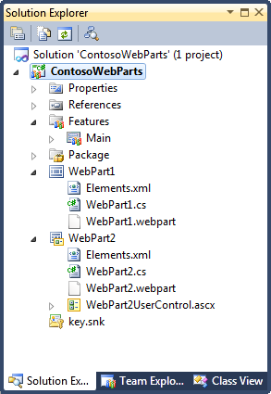
SharePoint 2010 Project Structure
Standard Project Nodes
Properties (standard with all Visual Studio projects)
References (standard with all Visual Studio projects)
Features (added by SharePoint Tools)
Package (added by SharePoint Tools)
SharePoint Project Items (added using SharePoint Tools Project Item Templates)
Notes:
When the project is created, the project has a typical structure. The Properties and References nodes are standard for all Visual Studio projects, but you will also have nodes like Package and Features. Depending on the type of SharePoint project you are creating, you will have some additional nodes reflecting the SharePoint project items you are creating.

Slide 12
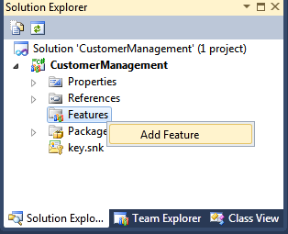
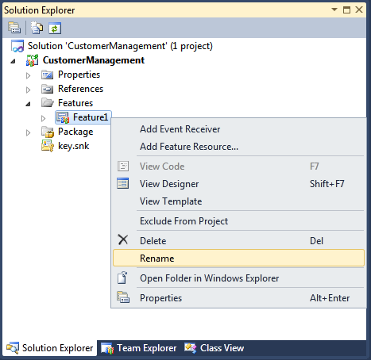
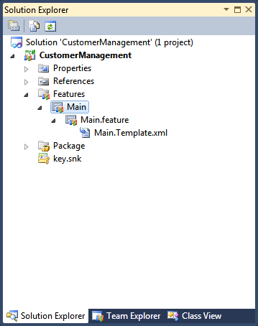
Adding a New Feature
Right-click Features node and select Add Feature
Right-click new feature node and select Rename
Notes:
You can add additional features to a SharePoint project by right-clicking the Features node and selecting Add Feature. Features have names like Feature1, Feature2,... You can best rename them to a meaning full name.

Slide 13
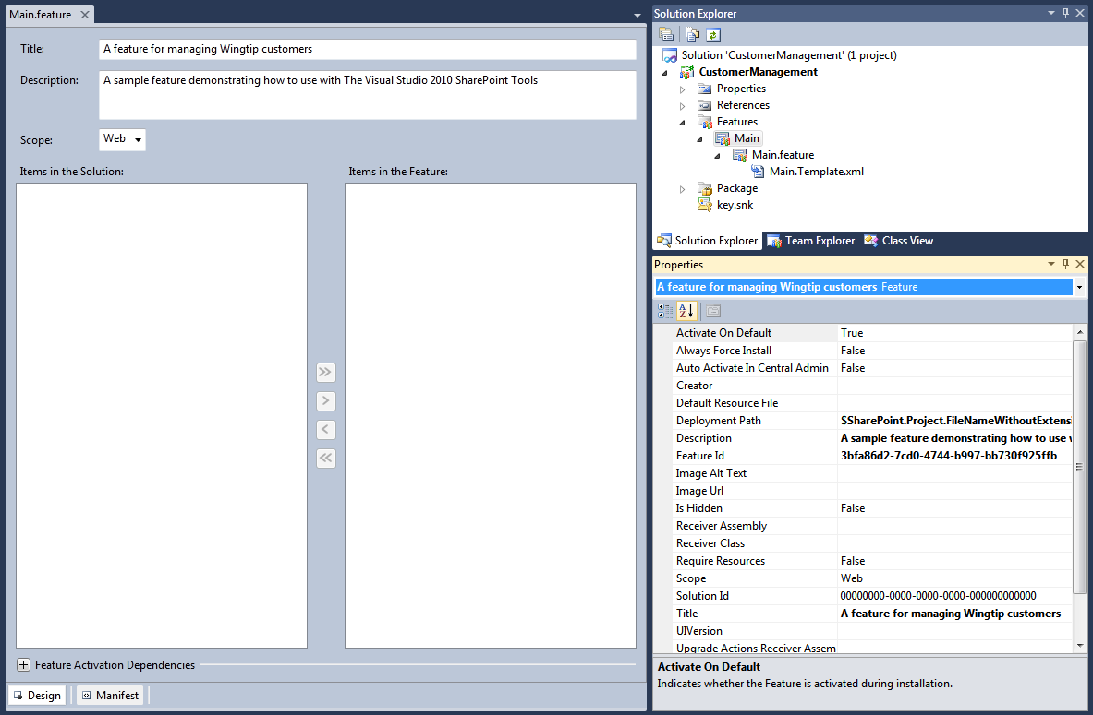
Feature Designer and Property Sheet
Each Feature has designer and property sheet
Feature designer provides design mode and XML text mode
Customize feature properties in designer and / or property grid
Feature designer allows adding / removing SPIs
Notes:
The Visual Studio Tools for SharePoint also come with a nice Feature Designer where you can change some properties like the title of the feature and its scope.
Each feature also has a property sheet where you can also modify properties.
If you need to make additional changes to the feature definition, you can edit the feature manifest by clicking the [+] button next to Edit Options and type in your changes.

Slide 14
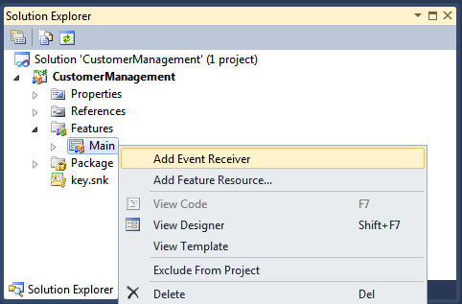
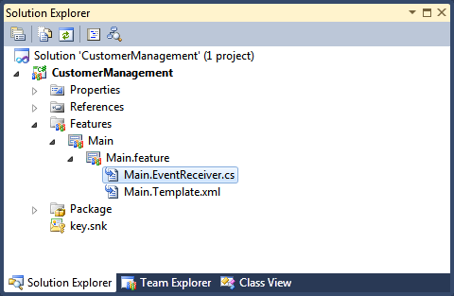
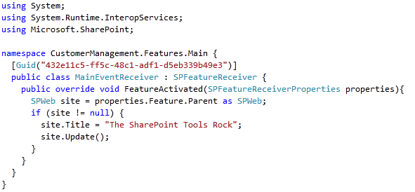
Creating a Feature Receiver
Notes:
If you need to perform actions while the feature gets activated in SharePoint, you can add a feature receiver by right-clicking the feature in the Features node and choosing Add Event Receiver. This will add a class to your project that inherits from SPFeatureReceiver. You can add code to events like FeatureActivated and FeatureDeactivated.

Slide 15
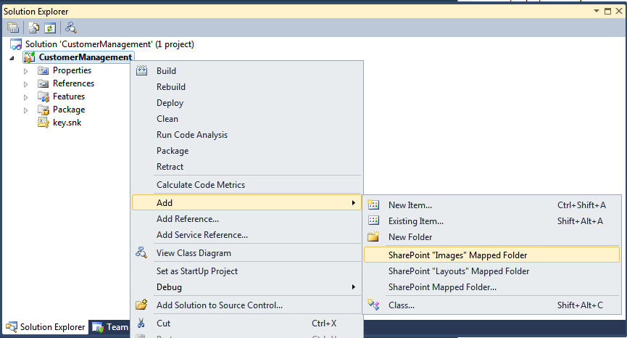
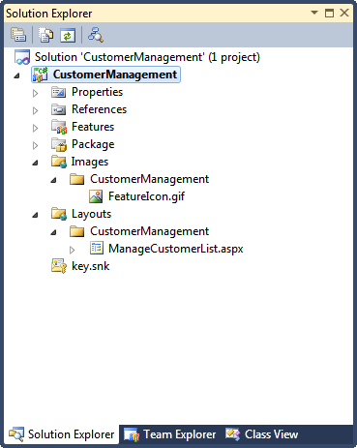
Mapped Folders
Mapped Folders used to deploy to SharePoint Root
Layouts mapped folder deploys to /_layouts virtual directory Layouts folder used to deploy application pages, CSS files, .js files, etc
Images mapped folder deploys to /_layouts/images Images folder used to deploy graphics files (eg .gif, .jpg, .png, etc)
Can create other mapped folders inside SharePoint Root directory
Notes:
Some SharePoint artifacts require you to deploy files to the SharePoint file system like f.e. application pages to the _layouts folder, or images to the _layouts/images folder. In Visual Studio 2010 you can do that by adding a mapped folder.
Right-click the project in the Solution Explorer, choose Add » SharePoint “Layouts” Mapped Folder or SharePoint “Images” Mapped Folder.
If you need to deploy files to another folder in the SharePoint root, you can choose Add » SharePoint Mapped Folder. A dialog will open where you can select the desired folder from a treeview representing the SharePoint folder tree.

Slide 16
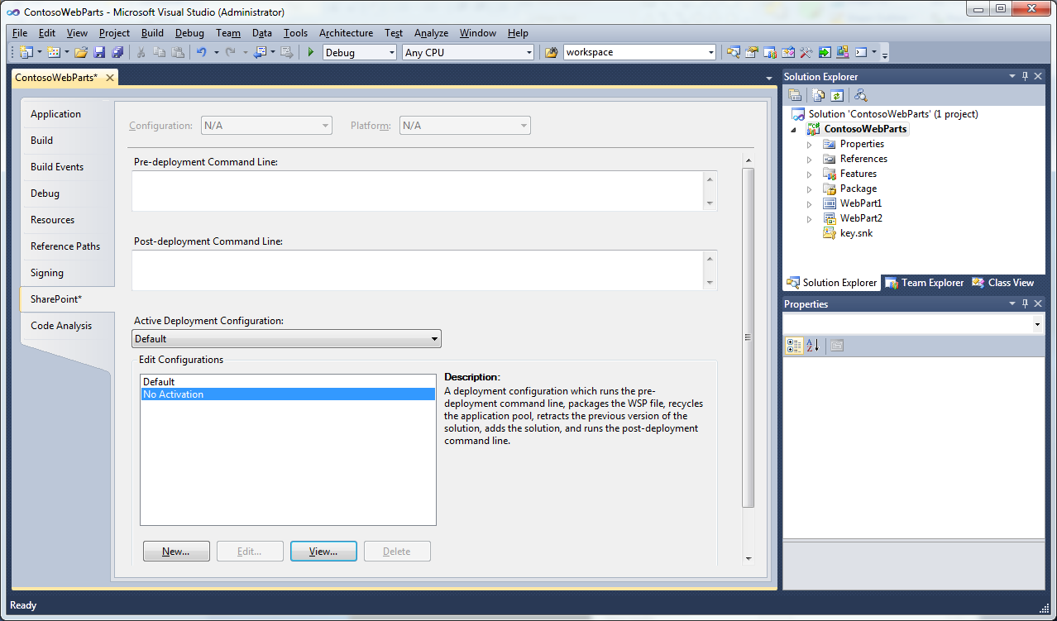
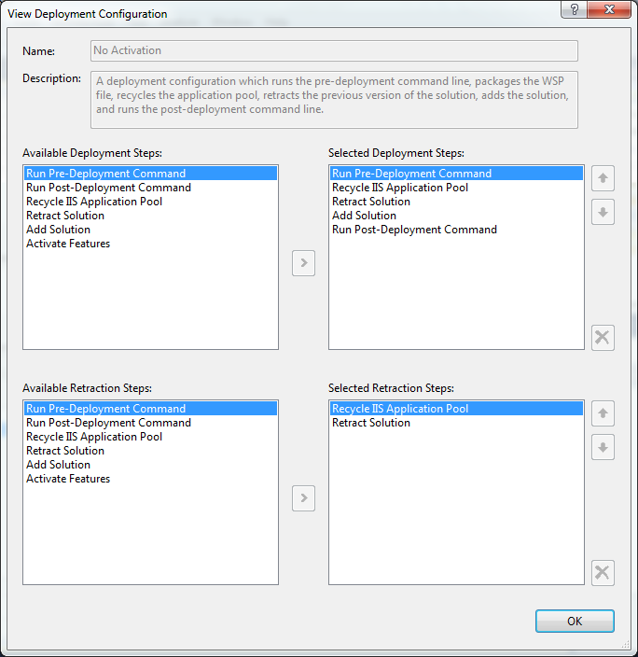
Deployment Configurations
Project contains set of deployment configurations
Projects created with Default and No Activation
You can create additional deployment configurations
SharePoint Tools extensions can add custom steps
Notes:
When it comes to deploying your SharePoint project, you can choose between different deployment configurations.
Right-click your project in the Solution Explorer and choose Properties. In the Properties window select the SharePoint tab. There are two standard deployment configurations: Default and No Activation. If needed, you can create your own deployment configuration. Clicking the New button opens a dialog where you can choose from a set of existing deployment steps.
Using Visual Studio 2010 SharePoint Tools extensions, you can add your own custom steps.

Slide 17
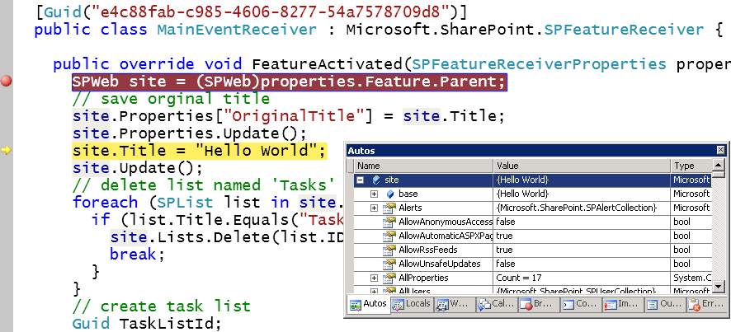
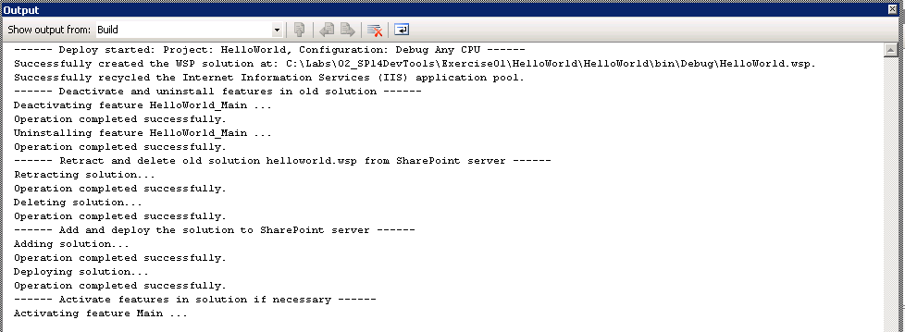
The F5 Debugging Experience
What does F5 do?
Builds new version of *.wsp file
Deactivates / uninstalls feature
Retracts / deletes old *.wsp file
Adds / deploys new *.wsp file
Activates feature in target site (via Site Url)
Attaches debugger to W3WP.EXE worker process (via Site URL)
Notes:
You can right-click the project in Solution Explorerand choose Deploy to deploy your SharePoint project. But you can also press [F5].
Pressing [F5] builds the *.wsp, deactivates/uninstalls the features if they were previously deployed, retracts/deletes the old *.wsp, adds/deploys the freshly build *.wsp, and activates the features in the target site. It also attaches the debugger to the W3WP.exe worker process, which is the SharePoint worker process and lets you debug your SharePoint code.

Slide 18
DEMO
Creating, Deploying and Debugging
a SharePoint Project

Slide 19
Agenda
Introduction to the SharePoint Tools
Creating a SharePoint Project
Adding SPIs to a SharePoint Project
SharePoint Tools Extensibility

Slide 20
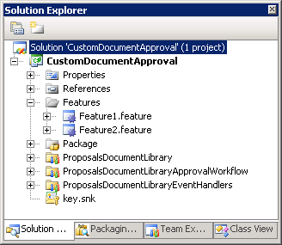
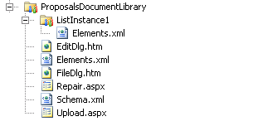


SharePoint Project Items (SPIs)
SharePoint Projects built using SPIs
SPI is a logical collection of project files Examples of SPIs are WebParts, List Defs, Workflows, etc
Each SPI has its own folder and SPI file collection
Notes:
SharePoint projects consists of SharePoint Project Items (SPIs). An SPI is a logical collection of project files.
For example, a Web Part consists of a class, an elements file and a *.webpartfile.
Visual Studio 2010 stores each SPI in its own folder.

Slide 21
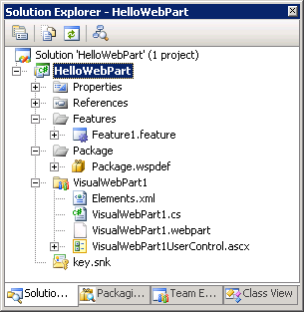




SPI File Properties
SharePoint Tools tracks properties for SPI files
Visual Studio properties for compilation
SharePoint 2010 properties for deployment
Notes:
SPI files also have their own set of properties that are specifically added for Visual Studio for compilation purposes, and specific properties for deployment purposes.

Slide 22
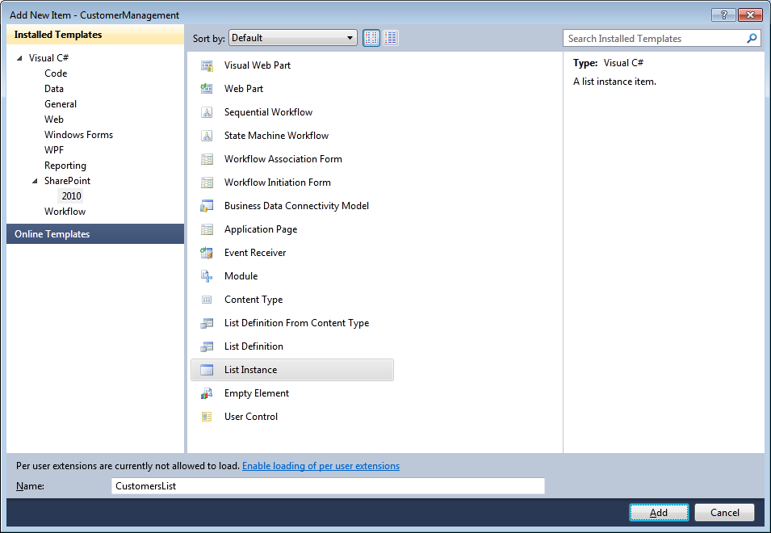
Creating SPIs from Project Item Templates
Notes:
You can create SharePoint Project Items by right-clicking the project in Solution Explorer and choosing Add » New Item. This opens a dialog where you can choose between the different SharePoint Project Item templates.

Slide 23
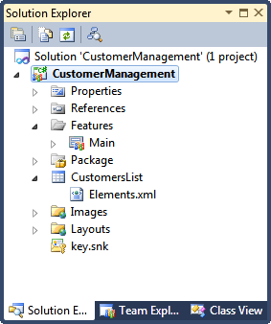
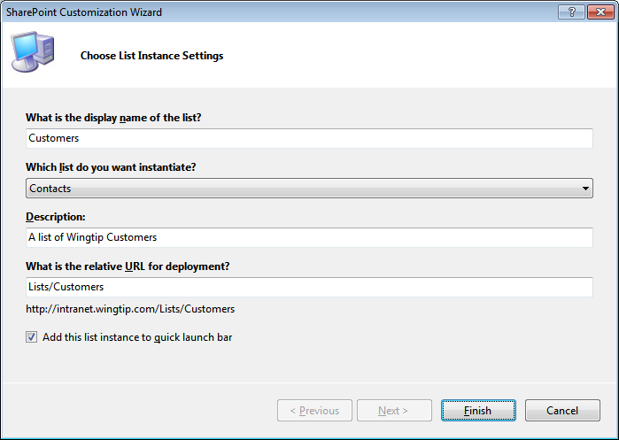
Creating an SPI for a List Instance
Notes:
When you are creating SPIs, you are always presented with a wizard. The questions and choice options in the wizard depend on the type of SPI you want to create.
When you choose to create an SPI for a list instance, the wizard will ask you to give the list instance a name and ask you to choose the type of list you want to create. It will also suggest a relative URL where the list instance will be deployed. Additionaly you can indicate if you want the list to appear on the Quick Launch or not.

Slide 24
DEMO
Adding SPIs to a SharePoint Project

Slide 25
Agenda
Introduction to the SharePoint Tools
Creating a SharePoint Project
Adding SPIs to a SharePoint Project
SharePoint Tools Extensibility

Slide 26
SharePoint 2010 Tools Extensibility
SharePoint 2010 Project system extensibility
Custom extensions integrate into Visual Studio 2010 designer experience
Used to create custom SPIs not supported out-of-box
Much easier than standard Visual Studio extensibility model
SPI & Context Menu extensibility
Extend VS context menu for standard and custom SPIs
Provide extensibility to enable access to SharePoint API
SharePoint Explorer Nodes & Menu extensibility
Create extension to add a node to the SharePoint Explorer
Create extension to enhance existing node
Notes:
You can extend the Visual Studio 2010 Project system by creating extensions that seamless that integrate into the Visual Studio 2010 designer experience.
You can extend Visual Studio context menus for standard and custom SPIs, create your own custom SPI templates, and much more.
You can find a very good example of extensibility on CodePlex (http://cksdev.codeplex.com) & the Visual Studio 2010 Gallery (http://visualstudiogallery.msdn.microsoft.com/en-us).

Slide 27
Extending VS2010 from the Online Gallery
Available in the Visual Studio 2010 Gallery
All free!
Many more extensions (free / trial / paid)
CKS:DEV
Available for just SPF2010 or SPS2010
Adds project templates, project item templates
Extends Server Explorer & adds read/write ops
Adds multiple deployment configs & options
Visual Studio 2010 SharePoint Power Tools
Adds sandbox compilation
Adds sandbox-compatible Visual Web Part
CAML.NET IntelliSense
Augments IntelliSense & documentation for CAML editing
Notes:
Visual Studio 2010 Online Gallery
http://visualstudiogallery.msdn.microsoft.com
CKS:DEV
SharePoint Foundation 2010 only extensions
http://visualstudiogallery.msdn.microsoft.com/a346880f-2d29-47a6-84a2-f2d568dd6997
SharePoint Server 2010 (includes SPF as well) extensions
http://visualstudiogallery.msdn.microsoft.com/ee876627-962c-4c35-a4a6-a4d89bfb61dc
Visual Studio 2010 SharePoint Power Tools:
http://visualstudiogallery.msdn.microsoft.com/8e602a8c-6714-4549-9e95-f3700344b0d9
CAML.NET IntelliSense
http://visualstudiogallery.msdn.microsoft.com/15055544-fda0-42db-a603-6dc32ed26fde

Slide 28
Summary
Introduction to the SharePoint Tools
Creating a SharePoint Project
Adding SPIs to a SharePoint Project
SharePoint Tools Extensibility

